Slide 1



KONGU ENGINEERING COLLEGE
PERUNDURAI ERODE-638060
Artificial Intelligence and Machine Learning
PROJECT WORK - Review 3
PetCognize: The Pet's Personal Guide
PRANESH M P - 21ALR032
SAMYUKTHA K - 21ALR035
SRIMATHI E - 21ALR044
Mentor :
Dr S KAYALVILI
ASSOCIATE PROFESSOR
DEPARTMENT OF AI

Slide 2
OBJECTIVE
Develop an innovative and user-friendly platform that provides reliable, accessible, and intelligent information on veterinary care, pet health, and general pet care practices to meet the growing needs of veterinary doctors, pet lovers, and pet owners. This platform should offer a seamless experience for users to access accurate information, seek advice, and engage in discussions related to pet care, ultimately enhancing the well-being and happiness of pets and their owners.

Slide 3



PROBLEM STATEMENT
The pet care industry is expanding rapidly, with an increasing number of pet owners seeking reliable and accessible information related to veterinary care, pet health, and general pet care practices. Traditional methods of accessing information can be time-consuming, and there is a growing need for a user-friendly and intelligent solution that caters to the specific queries of veterinary doctors, pet lovers, and pet owners.

Slide 4
CURRENT CHALLENGES
Information Overload: The vast amount of data in veterinary-related case studies and pet care encyclopedias can be overwhelming for users.
Language Barriers: Pet owners and veterinary professionals may come from diverse linguistic backgrounds, making it challenging to cater to a wide audience.
User Engagement: Maintaining user interest and engagement in a chatbot interface requires an effective combination of intuitive design and compelling content.
Accuracy and Reliability: Ensuring that the chatbot provides accurate and reliable information is crucial, especially in the field of pet care where misinformation can have serious consequences.

Slide 5
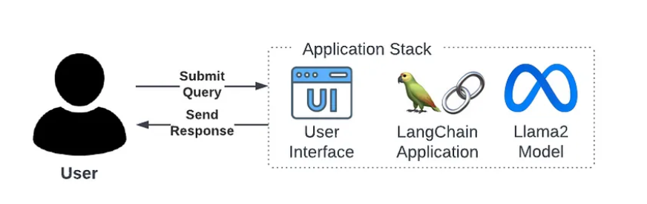
PROPOSED SOLUTION
PetCare AI ChatBot:
Data Source:
Utilize veterinary-related case studies, dog care encyclopedias, and various relevant documents to train the chatbot on a comprehensive dataset.
Embedding Model:
Implement the Multilingual E5 embedding model to enable the chatbot to understand and respond to queries in multiple languages, enhancing its accessibility.

Slide 6
LLM (Large Language Model):
Leverage the power of Llama 2, an open-source large language model developed by meta AI, to enhance the chatbot natural language processing capabilities.
Framework:
Employ LangChain as the underlying framework for PetCare AI ChatBot, providing a robust structure for seamless integration of language models and efficient query processing.
Backend:
Implement Fast API for the backend, ensuring fast and efficient communication between the frontend interface and the underlying language model.
UI (User Interface):
Utilize Bootstrap V5 to design a user-friendly interface, ensuring a smooth and visually appealing experience for users.

Slide 7
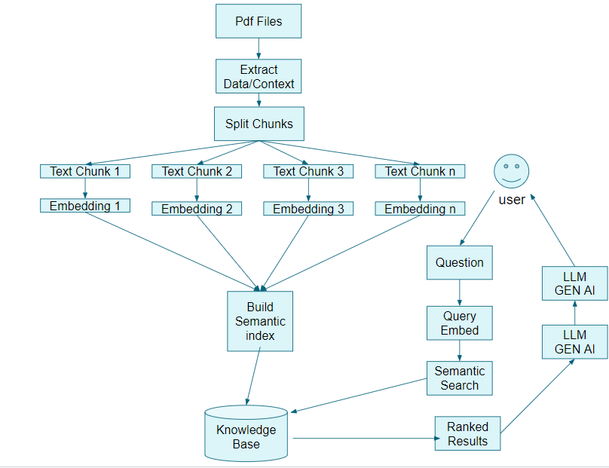
Implementation Flow

Slide 8
DATASET DETAILS
Pet Encyclopedias
150 diseases
precautions
medication
Case studies
Case study in canine intestinal lymphangiectasia
Pets Article
Case study on Pet Maintenance

Slide 9
BASE PAPER
Cataract Bot: an LLM- Powered Expert in the -Loop Chatbot for Cataract patients
Authors : Pragnya Ramjee,Bhuvan Sachdeva,Satvik Golechha ,Shreyas Kulkarni
Published : 7 Feb 2024
Methodology :
Methodology for Evaluating the LLM-Powered Expert-in-the-Loop Chatbot for Cataract Surgery Patients:
1. Study Design and Setting:
- Mixed-method user study conducted at Sankara Eye Hospital, Bengaluru, India, in collaboration with the hospital.
- Collaboration approved by the Scientific and Ethics Committees of Sankara Eye Hospital.

Slide 10
2. Participant Selection:
- Patients undergoing cataract surgery were selected based on specific criteria:
- Age 18 or older.
- Fluent in English, Hindi, Kannada, Tamil, or Telugu.
- Scheduled for cataract surgery within a week.
- No history of cataract surgery in the last 6 months.
- Patient of one of the three participating operating doctors.
3. Procedure for Patients and Attendants:
- Patient coordinator assesses eligibility and directs eligible patients to the researcher.
- Introduction to Cataract Bot and study protocol explained by the researcher.
- Participants provide consent and fill a web-based onboarding form.
- Participants receive welcome messages from Cataract Bot and are instructed to ask trial questions.

Slide 11
- Two daily reminder messages sent to participants prompting them to engage with Cataract Bot.
- Participants use the bot from onboarding to one week post-surgery.
- Two interviews conducted with both patient and attendant: one on the surgery day and another a week post-surgery.
- Semi-structured interviews explore overall experience, specific features liked/disliked, suggestions for improvement, and assessment of trustworthiness, timeliness, and accuracy of responses.
- Participants fill out a chatbot usability form after each interview, rating their experience on various aspects.

Slide 12
4. Data Collection Instruments:
- Chatbot usability form: participants rate their experience through eight questions on a five-point Likert scale.
- Semi-structured interview guide: covers overall experience, specific features liked/disliked, suggestions for improvement, and assessment of trustworthiness, timeliness, and accuracy of responses.
5. Data Analysis:
- Mixed-method approach combining qualitative analysis of interview transcripts and quantitative analysis of chatbot usability ratings.

Slide 13
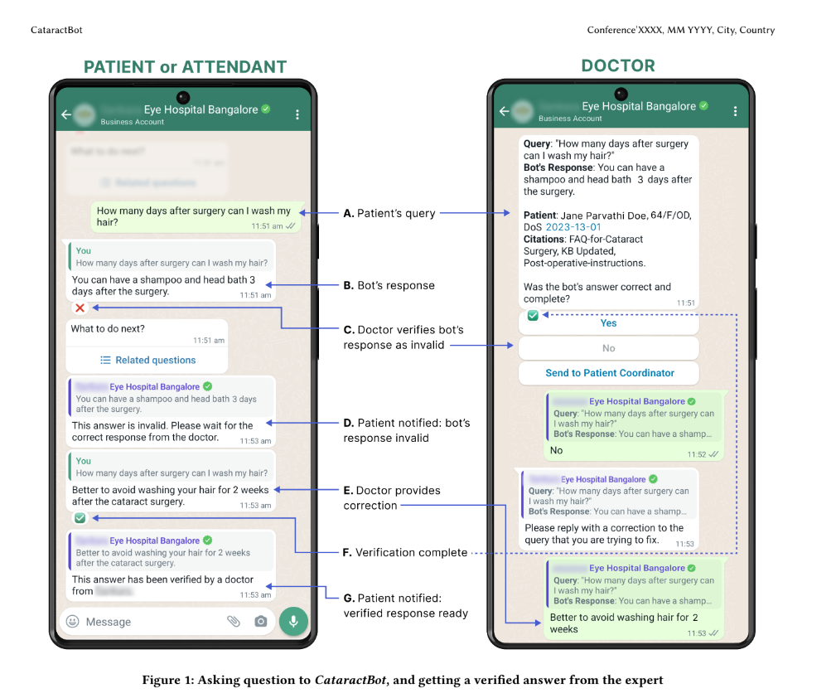
7. Ethical Considerations:
- Approval obtained from the Scientific and Ethics Committees of Sankara Eye Hospital.
- Informed consent obtained from all participants.
- Participant confidentiality and privacy maintained throughout the study.

Slide 14
Literature Survey
Sno | Title | Author | Methodology
1 | Improving Language Understanding by Generative Pre-Training, 2023 | Alec Radford, Karthik Narasimhan, Tim Salimans, Ilya Sutskever | The paper introduces the Generative Pre-trained Transformer (GPT) model, which utilizes unsupervised pre-training on large text corpora followed by supervised fine-tuning for specific tasks. The methodology involves training a large-scale language model on diverse text data to learn rich contextual representations of language, enabling it to perform a wide range of natural language processing tasks.
2 | BERT: Pre-training of Deep Bidirectional Transformers for Language Understanding, 2022 | Jacob Devlin, Ming-Wei Chang, Kenton Lee, Kristina Toutanova | This paper presents the Bidirectional Encoder Representations from Transformers (BERT) model, which is pre-trained on large text corpora using a masked language modeling objective and a next sentence prediction task. The methodology involves training a deep bidirectional transformer model to generate contextualized word representations, enabling it to capture complex linguistic relationships and semantics.

Slide 15
3 | XLNet: Generalized Autoregressive Pre training for Language Understanding,2022 | Zhilin Yang, Zihang Dai, Yiming Yang, Jaime Carbonell, Ruslan Salakhutdinov, Quoc V. Le | This paper introduces XLNet, a generalized autoregressive pre-training method for language understanding. The methodology involves training an autoregressive language model by modeling the joint probability of sequences with permutations, enabling the model to capture bidirectional context and alleviate the limitations of traditional left-to-right or right-to-left autoregressive models.
4 | RoBERTa: A Robustly Optimized BERT Approach,2023 | Yinhan Liu, Myle Ott, Naman Goyal, Jingfei Du, Mandar Joshi, Danqi Chen, Omer Levy, Mike Lewis, Luke Zettlemoyer, Veselin Stoyanov. | This paper presents RoBERTa, a robustly optimized BERT approach, which aims to improve the pre-training procedure and hyperparameter tuning for BERT models. The methodology involves training BERT with larger mini-batches, more training data, and longer training schedules, along with dynamically changing hyperparameters, resulting in improved performance on downstream natural language understanding tasks.

Slide 16
EXPECTED OUTCOMES
Accessible Information: Provide users with easy access to accurate and reliable information on veterinary care, pet health, and general pet care practices.
Multilingual Support: Cater to a diverse audience by supporting multiple languages, breaking down language barriers in the pet care community.
User Engagement: Enhance user engagement through an intuitive and visually appealing UI, encouraging users to seek and interact with the chatbot.
Reliability: Ensure the chatbot delivers accurate information, promoting trust among users, including veterinary professionals and pet owners.

Slide 17
Techniques/Tools
Streamlit: Python library for creating interactive web apps.
Langchain: Framework for building conversational AI systems.
Conversational Retrieval Chain: Combines retrieval from document embeddings with a large language model (LLM).
Hugging Face Embeddings: Creates sentence embeddings for document retrieval.
FAISS Vector Store: Stores and retrieves document embeddings efficiently.
Replicate: Connects to a Replicate-hosted LLM for text generation.
Conversation Buffer Memory: Tracks conversation history for context.
Loaders: Extract text from different document formats (PDF, Docx, Txt).
Text Splitter: Splits documents into manageable chunks.
Google Generative AI (GAI): Generates text descriptions from images.

Slide 18
MODEL DESCRIPTION
Model Name: Llama-2-7b-chat.ggmlv3.q4_0.bin
Type: Large language model (LLM)
Generation: Llama 2 (second generation)
Size: 7 billion parameters (7b)
Fine-tuned for: Chat conversations and dialogue systems
Architecture: ggmlv3
Quantization: 4-bit quantization (q4) for reduced storage and faster inference (batch 0)

Slide 19
SENTENCE EMBEDDING MODEL
all-MiniLM-L6-v2
Source: sentence-transformers library
Purpose: Generates sentence embeddings
Model Details:
Architecture: Based on MiniLM, a compact and efficient variant of BERT (Bidirectional Encoder Representations from Transformers)
Number of Encoder Layers: 6 (L6) - This refers to the depth of the neural network used for encoding sentences.
Version: v2 - This likely indicates the second iteration of the model, potentially with improvements over the original version.

Slide 20
Gemini-Pro-Vision
Gemini Pro Vision: A Multimodal Mastermind
Type: Multimodal Large Language Model (LLM)
Description:
A powerful AI model by Google that can understand and process both text and visual information (images, videos). This sets it apart from traditional LLMs that only deal with text.

Slide 21
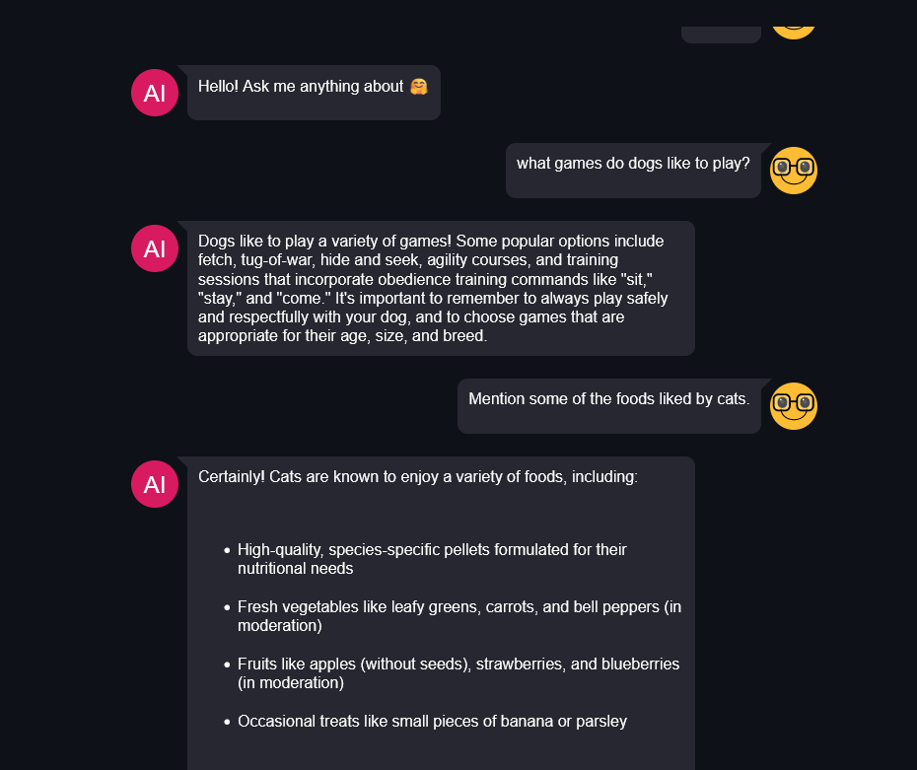
INTERMEDIATE RESULTS

Slide 22
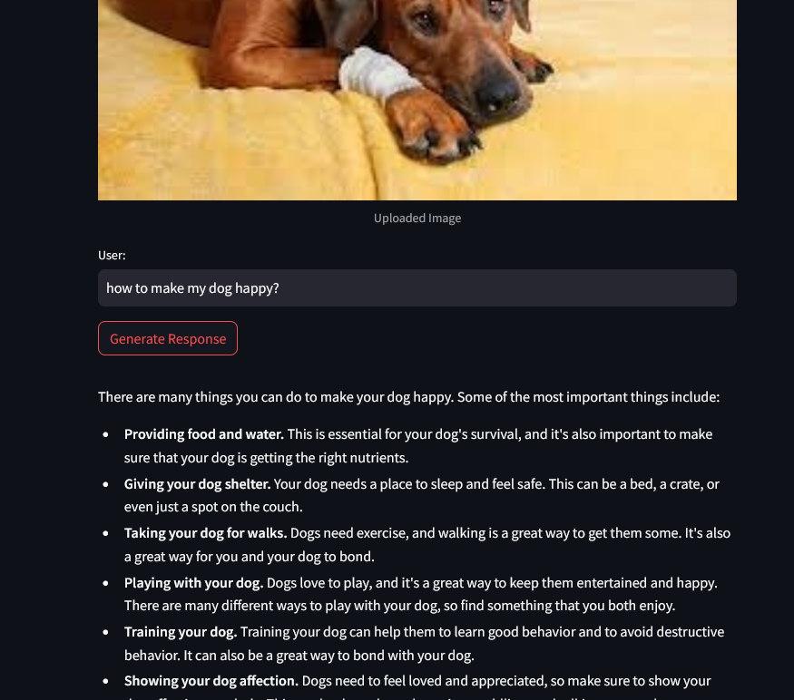

Slide 23
REFERENCES
DOCUMENTATIONS:
PAPERS:
Long Chain Docs: https://python.langchain.com/docs/get_started/introduction.html
FAISS Docs: https://faiss.ai/index.html
Multilingual E5 Large Embedding Model: https://huggingface.co/intfloat/multilingual-e5-large
Llama 2 by Meta AI: https://huggingface.co/meta-llama/Llama-2-7b
[1] Appleby, R. B., & Basran, P. S . Artificial intelligence in veterinary medicine. Journal of the American Veterinary Medical Association, 260(8), 819-824, 2022.
[2] Al Badrani, B. A., Abdel-Raheem, M. A., & Al-Farwachi, M. I.. " Artificial Intelligence in Veterinary Care: A Review of Applications for Animal Health. Egyptian Journal of
Veterinary Sciences, 55(6), 1725-1736, 2024.

Slide 24
[3] Angel, M., Patel, A., Xing, H., Balsz, D., Arbuckle, C., Bruyette, D., & Baldi, P. AI and Veterinary Medicine: Performance of Large Language Models on the North American Licensing Examination. In 2023 Tenth International Conference on Social Networks Analysis, Management and Security (SNAMS) (pp. 1-4). IEEE, 2023, November.
[4] Bair, Henry1; Norden, Justin MD, MBA, MPhil 2. Large Language Models and Their Implications on Medical Education. Academic Medicine 98(8):p 869-870, August 2023.
[5] Basran, P. S., & Appleby, R. B. The unmet potential of artificial intelligence in veterinary medicine. American Journal of Veterinary Research, 83(5), 385-392,2022.
[6] Bellamy JEC. Artificial intelligence in veterinary medicine requires regulation. Can Vet . 2023 Oct;64(10):968-970. PMID: 37780472; PMCID: PMC10506349, 2023.
[7] Boissady, E., de La Comble, A., Zhu, X., & Hespel, A. M. Artificial intelligence evaluating primary thoracic lesions has an overall lower error rate compared to veterinarians or veterinarians in conjunction with artificial intelligence. Veterinary Radiology & Ultrasound, 61(6), 619-627, 2020.
[8] Bouhali, O., Bensmail, H., Sheharyar, A., David, F., & Johnson, J. P. A review of radionics and artificial intelligence and their application in veterinary diagnostic imaging. Veterinary Sciences, 9(11), 620, 2022.

Slide 25
[10] Chu, C. P. ChatGPT in Veterinary Medicine: A Practical Guidance of Generative Artificial Intelligence in Clinics, Education, and Research. arXiv preprint arXiv:2403.14654, 2024.
[11] Cihan, P. Et Al. A Review of Machine Learning Applications in the Veterinary Field. KAFKAS UNIVERSITESI VETERINER FAKULTESI DERGISI , vol.23, no.4 , 673-680, 2017.
[12] Gulzar, M. W., & Hussain, J. The implementation of artificial intelligence in veterinary diseases and practices. A comprehensive review. Hosts and Viruses, 10, 43-50, 2023.
[13] Huang, D. H., & Chueh, H. E . Chatbot usage intention analysis: Veterinary consultation. Journal of Innovation & Knowledge, 6(3), 135-144, 2021.
[14] Pragnya Ramjee, Bhuvan Sachdeva, Satvik Golechha, Shreyas Kulkarni, Geeta Fulari, Kaushik Murali, Mohit Jain, Cataract Bot: An LLM-Powered Expert-in-the-Loop Chatbot for Cataract Patients. Cornell University, on 7 Feb 2024.
[15] Zhang, L., Guo, W., Lv, C., Guo, M., Yang, M., Fu, Q., & Liu, X. Advancements in artificial intelligence technology for improving animal welfare: Current applications and research progress. Animal Research and One Health, 2(1), 93-109, 2024.

Slide 26
Thank You !!

